Slide 1
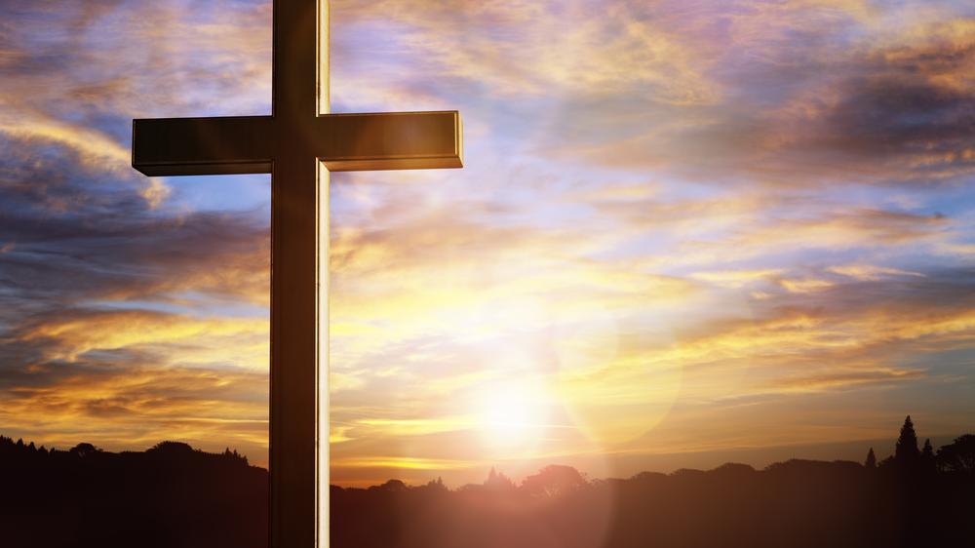
Discovering Life in Jesus Christ John 11:1-46

Slide 2
John 11:1-46
¹ Now a man named Lazarus was sick. He was from Bethany, the village of Mary and her sister Martha. ² (This Mary, whose brother Lazarus now lay sick, was the same one who poured perfume on the Lord and wiped his feet with her hair.) ³ So the sisters sent word to Jesus, “Lord, the one you love is sick.”
⁴ When he heard this, Jesus said, “This sickness will not end in death. No, it is for God’s glory so that God’s Son may be glorified through it.” ⁵ Now Jesus loved Martha and her sister and Lazarus. ⁶ So when he heard that Lazarus was sick, he stayed where he was two more days, ⁷ and then he said to his disciples, “Let us go back to Judea.”

Slide 3
John 11:1-46
⁸ “But Rabbi,” they said, “a short while ago the Jews there tried to stone you, and yet you are going back?”
⁹ Jesus answered, “Are there not twelve hours of daylight? Anyone who walks in the daytime will not stumble, for they see by this world’s light. ¹⁰ It is when a person walks at night that they stumble, for they have no light.”
¹¹ After he had said this, he went on to tell them, “Our friend Lazarus has fallen asleep; but I am going there to wake him up.”
¹² His disciples replied, “Lord, if he sleeps, he will get better.” ¹³ Jesus had been speaking of his death, but his disciples thought he meant natural sleep.
¹⁴ So then he told them plainly, “Lazarus is dead, ¹⁵ and for your sake I am glad I was not there, so that you may believe. But let us go to him.”
¹⁶ Then Thomas (also known as Didymus) said to the rest of the disciples, “Let us also go, that we may die with him.”

Slide 4
John 11:1-46
¹⁷ On his arrival, Jesus found that Lazarus had already been in the tomb for four days. ¹⁸ Now Bethany was less than two miles from Jerusalem, ¹⁹ and many Jews had come to Martha and Mary to comfort them in the loss of their brother. ²⁰ When Martha heard that Jesus was coming, she went out to meet him, but Mary stayed at home.
²¹ “Lord,” Martha said to Jesus, “if you had been here, my brother would not have died. ²² But I know that even now God will give you whatever you ask.”
²³ Jesus said to her, “Your brother will rise again.”
²⁴ Martha answered, “I know he will rise again in the resurrection at the last day.”
²⁵ Jesus said to her, “I am the resurrection and the life. The one who believes in me will live, even though they die; ²⁶ and whoever lives by believing in me will never die. Do you believe this?”
²⁷ “Yes, Lord,” she replied, “I believe that you are the Messiah, the Son of God, who is to come into the world.”

Slide 5
John 11:1-46
²⁸ After she had said this, she went back and called her sister Mary aside. “The Teacher is here,” she said, “and is asking for you.” ²⁹ When Mary heard this, she got up quickly and went to him. ³⁰ Now Jesus had not yet entered the village, but was still at the place where Martha had met him. ³¹ When the Jews who had been with Mary in the house, comforting her, noticed how quickly she got up and went out, they followed her, supposing she was going to the tomb to mourn there.
³² When Mary reached the place where Jesus was and saw him, she fell at his feet and said, “Lord, if you had been here, my brother would not have died.”
³³ When Jesus saw her weeping, and the Jews who had come along with her also weeping, he was deeply moved in spirit and troubled. ³⁴ “Where have you laid him?” he asked.
“Come and see, Lord,” they replied.
³⁵ Jesus wept.

Slide 6
John 11:1-46
³⁶ Then the Jews said, “See how he loved him!”
³⁷ But some of them said, “Could not he who opened the eyes of the blind man have kept this man from dying?”
³⁸ Jesus, once more deeply moved, came to the tomb. It was a cave with a stone laid across the entrance. ³⁹ “Take away the stone,” he said.
“But, Lord,” said Martha, the sister of the dead man, “by this time there is a bad odor, for he has been there four days.”
⁴⁰ Then Jesus said, “Did I not tell you that if you believe, you will see the glory of God?”

Slide 7
John 11:1-46
⁴¹ So they took away the stone. Then Jesus looked up and said, “Father, I thank you that you have heard me. ⁴² I knew that you always hear me, but I said this for the benefit of the people standing here, that they may believe that you sent me.”
⁴³ When he had said this, Jesus called in a loud voice, “Lazarus, come out!” ⁴⁴ The dead man came out, his hands and feet wrapped with strips of linen, and a cloth around his face.
Jesus said to them, “Take off the grave clothes and let him go.”
⁴⁵ Therefore many of the Jews who had come to visit Mary, and had seen what Jesus did, believed in him. ⁴⁶ But some of them went to the Pharisees and told them what Jesus had done.

Slide 8
Introduction
³ So the sisters sent word to Jesus, “Lord, the one you love is sick.”
⁵ Now Jesus loved Martha and her sister and Lazarus.
Jesus loved Martha, Mary and Lazarus. But, he did not go to Bethany immediately.
⁴“This sickness will not end in death. No, it is for God’s glory so that God’s Son may be glorified through it.”
“Glory” or “glorified”:
1. Self-disclosure, a revelation of who Jesus is
2. The death of Jesus on the cross brings God glory

Slide 9
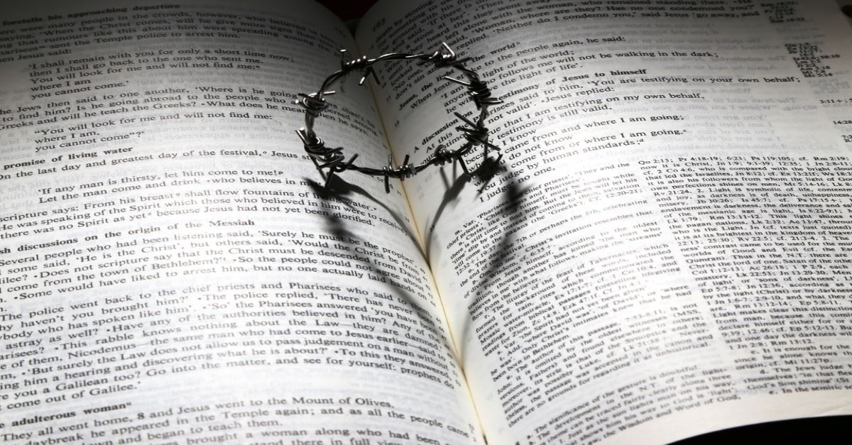
Later than expected (vv. 5-6)
⁵ Now Jesus loved Martha and her sister and Lazarus. ⁶ So when he heard that Lazarus was sick, he stayed where he was two more days.
How can Jesus’ delay be motivated by his love for Martha, Mary and Lazarus?
(i) Waiting for the Father’s timing
(ii) Long enough so that no one could misinterpret or dispute the miracle [There were superstitions that the spirit of a deceased may re-enter the body the first 3 days.]
(iii) Healing Lazarus would cost Jesus the opportunity to teach and strengthen their faith in a way that would not be possible without the death of Lazarus

Slide 10
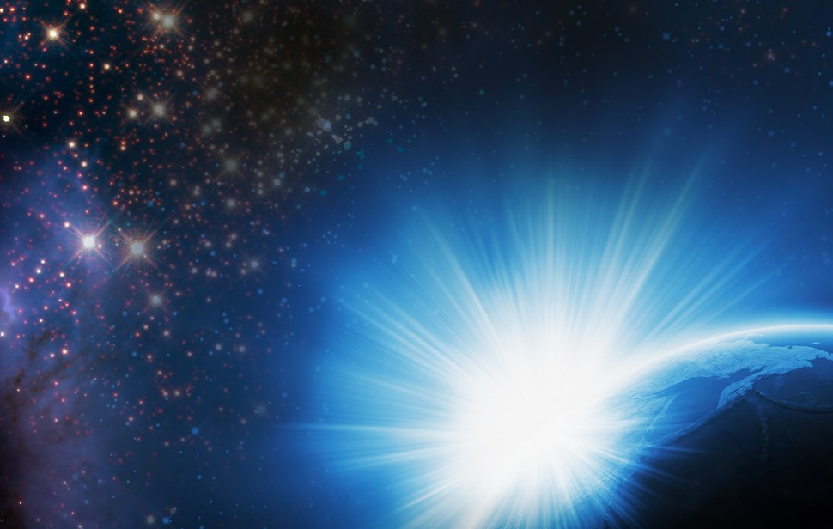
The disciples’ concerns and response (vv. 8-16)
⁸ “But Rabbi, a short while ago the Jews there tried to stone you, and yet you are going back?” (cf. John 10:39)
Jesus and the disciples were faced with opposition and death threats in Jerusalem, and it would certainly be dangerous to go Bethany which is only 2 miles away from Jerusalem. Their concerns were valid.
⁹ Jesus answered, “Are there not twelve hours of daylight? Anyone who walks in the daytime will not stumble, for they see by this world’s light. ¹⁰ It is when a person walks at night that they stumble, for they have no light.”
During the time of Jesus, one day is divided into 12 hours of daylight and 12 hours of night.
There is a time to work/walk; there is a time that we can no longer work/walk (when darkness comes).
Jesus knew his time on earth is numbered and he is to complete the tasks that is given to him.

Slide 11
The disciples’ concerns and response (vv. 8-16)
John 8:12, “I am the light of the world. Whoever follows me will never walk in darkness, but will have the light of life.”
Jesus was assuring his disciples that those who walk in the light, in the will of God (even if it leads to death), does not stumble.
This is an important truth that we need to hold on to.
How does this truth affect us in our concerns and decision making?
¹⁶ Then Thomas (also known as Didymus) said to the rest of the disciples, “Let us also go, that we may die with him.”
Thomas was not speaking out of doubt or sarcasm. Even though he has misunderstood and misinterpreted what Jesus said, Thomas responded out of raw devotion and courage, in spite of fear.

Slide 12
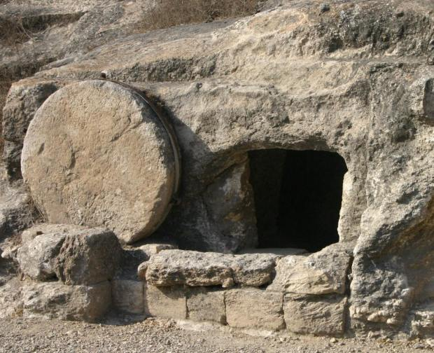
What we think we need (vv. 21 & 32)
“Lord, if you had been here, my brother would not have died.”
Martha and Mary’s words show grief, disappointment, and faith in Jesus:
(i) They have confidence that Jesus could have healed Lazarus
(ii) They mourn for the loss of their beloved brother (iii) They transparently confessed their disappointment that Jesus did not come to heal Lazarus
(iv) Their grief and complain did not lead to losing their faith

Slide 13
What we think we need (vv. 21 & 32)
“Lord, if you had been here, my brother would not have died.”
Martha and Mary’s words show grief, disappointment, and faith in Jesus:
Jesus did not rebuke them but responds with compassion. How comforting it is to have a God who allows us to be honest and transparent before him; and responds to us with love.
Grief + disappointment + complain (towards God) doesn’t equal to lack of faith.

Slide 14
What Jesus says we need (vv. 25-26)
Martha and Mary thought their need is to have Lazarus alive with them. But, Jesus confronts them and showed them what they really needed.
²⁵ Jesus said to her, “I am the resurrection and the life. The one who believes in me will live, even though they die; ²⁶ and whoever lives by believing in me will never die. Do you believe this?”
Just as Jesus not only gives the bread from heaven (John 6:27) but is himself the bread of life (6:35), so also he not only raises the dead on the last day (5:21, 25) but is himself the resurrection and the life.
There is neither resurrection nor eternal life outside of Jesus.
Reflect: What are my needs? According to Jesus, what are my real needs?

Slide 15
What Jesus says we need (vv. 25-26)
“I am the resurrection and the life.”
(i) “The one who believes in me will live, even though they die.”
The final resurrection of believer at the last day. As believers, even though we die, we will come to life at the final resurrection.
(ii) “and whoever lives by believing in me never die.”
Not about physical life and physical death; but the life of God, the eternal life that Jesus gives starting this lifetime. We can enjoy the resurrected life here on earth, and this resurrected life will in some sense never end, because the life that Jesus gives doesn’t end with physical death. Our physical life fades away but the life that Jesus gives never ends.

Slide 16
What Jesus says we need (vv. 25-26)
What is eternal life?
John 3:16 “For God so loved the world that he gave his one and only Son, that whoever believes in him shall not perish but have eternal life.” | John 17:2-3 “² For you [Father] granted him [Son] authority over all people that he might give eternal life to all those you have given him. ³ Now this is eternal life: that they know you, the only true God, and Jesus Christ, whom you have sent.”

Slide 17
What Jesus says we need (vv. 25-26)
Philippians 3:7-9, “⁷ But whatever were gains to me I now consider loss for the sake of Christ. ⁸ What is more, I consider everything a loss because of the surpassing worth of knowing Christ Jesus my Lord, for whose sake I have lost all things. I consider them garbage, that I may gain Christ ⁹ and be found in him.”
A person who clings on to the world fears death as it is the end of life that he/she clung on to. A person who clings to God enjoys the eternal life on earth, yet does not fear death, because life in Christ does not end in death. He/she enjoys the resurrected life on earth but looks forward to the resurrected life in full measure at the last day.
If we enjoy life with Christ on earth, we will enjoy life with Christ in heaven. If we do not enjoy life with Christ on earth, what makes us think we will enjoy life with Christ in heaven?

Slide 18
Jesus’ grief and anger (vv. 33-37)
³³ When Jesus saw her weeping, and the Jews who had come along with her also weeping, he was deeply moved in spirit and troubled. | ³⁷ But some of them said, “Could not he who opened the eyes of the blind man have kept this man from dying?” ³⁸ Jesus, once more deeply moved, came to the tomb.
Greek word: ἐμβριμάομαι “embrimaomai”, means anger, outrage, emotional indignation
Jesus was grieving with them because he loved them, but he was also angry. He was angry with the sin, sickness and death in this fallen world; and he was angry with the unbelief, especially the unbelief of the Jews in verse 37.
The faith of the Jews was built on the display of the power of Jesus, instead of who Jesus is. This kind of faith constantly demands new signs and miracles.

Slide 19
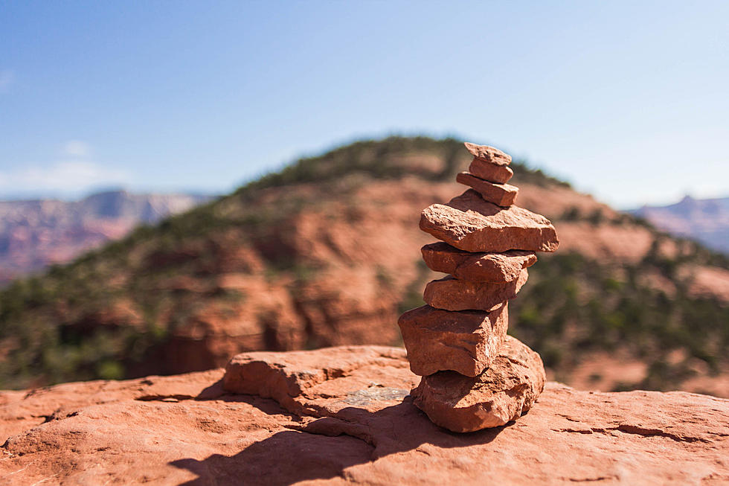
What is our faith built on?
Is our faith dependent on the display of God’s power in our lives, on how good our life is; or is it built on the person of Jesus Christ?
Tree planted and not shaken (Psalm 1)
Rejoice always (Philippians 4)
Take refuge under the wings of the Almighty (Psalm 91)
Rest in the assurance of the Lord

Slide 20
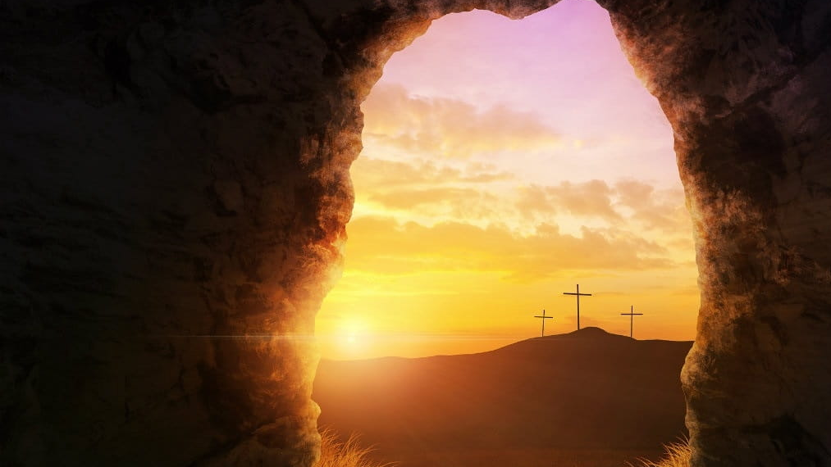
“I am the resurrection and the life. The one who believes in me will live, eventhough they die; ²⁶ and whoever lives by believing in me will never die. Do you believe this?”
The raising of Lazarus:
an acted example of
Jesus as
the Resurrection
and the Life.

Slide 21
Our timing vs. God’s timing
What we think we need vs. what Jesus says we need
The foundation of our faith: on the display of God’s power or on the person of Jesus Christ
Jesus’ compassion and grief: God does all things out of love

Slide 22
Response
⁴⁵ Therefore many of the Jews who had come to visit Mary, and had seen what Jesus did, believed in him. ⁴⁶ But some of them went to the Pharisees and told them what Jesus had done.
What would our response be?
Will we remain the same?
Will we allow God to change our lives?

Slide 23
Prayer Items
1. Praise & Thanksgiving
“The Word became flesh and made his dwelling among us.” (John 1:14)
A high priest who understands
Hebrews 4:15-16, ¹⁵ For we do not have a high priest who is unable to empathize with our weaknesses, but we have one who has been tempted in every way, just as we are—yet he did not sin. ¹⁶ Let us then approach God’s throne of grace with confidence, so that we may receive mercy and find grace to help us in our time of need.
2. Knowing, understanding, grasping & resting in the love of God
Trust in God’s timing
Trust that God knows our needs
Discern and respond to our real needs that God reveals
The foundation of our faith to be built on the person of Jesus Christ
3. Conditional MCO: protection; trust in the Lord knowing that he is good, he cares and he is sovereign
4. Those who are sick (Covid-19 & others) & their family; cure & vaccine: researchers
5. Front-liners: medical officers; armed forces
6. Leaders & government: wisdom, compassion, righteousness
7. Economy: especially those who are badly affected: poor, homeless, more vulnerable people (elderly, sick), refugees
8. Church: our response & calling as “light, salt and city on a hill” – be the Gospel of God’s love

