Slide 1
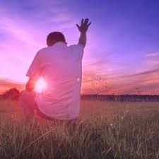
Living For God
1 Peter 4:1-11

Slide 2
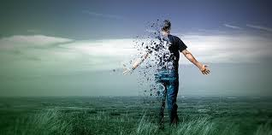
1 Peter 4: 1-11
1 Peter 4:1-11 (NIV) ​¹ Therefore, since Christ suffered in his body, arm yourselves also with the same attitude, because whoever suffers in the body is done with sin. ² As a result, they do not live the rest of their earthly lives for evil human desires, but rather for the will of God. ³ For you have spent enough time in the past doing what pagans choose to do—living in debauchery, lust, drunkenness, orgies, carousing and detestable idolatry. ⁴ They are surprised that you do not join them in their reckless, wild living, and they heap abuse on you. ⁵ But they will have to give account to him who is ready to judge the living and the dead. ⁶ For this is the reason the gospel was preached even to those who are now dead, so that they might be judged according to human standards in regard to the body, but live according to God in regard to the spirit.

Slide 3
1 Peter 4: 1-11
⁷ The end of all things is near. Therefore be alert and of sober mind so that you may pray. ⁸ Above all, love each other deeply, because love covers over a multitude of sins. ⁹ Offer hospitality to one another without grumbling. ¹⁰ Each of you should use whatever gift you have received to serve others, as faithful stewards of God’s grace in its various forms. ¹¹ If anyone speaks, they should do so as one who speaks the very words of God. If anyone serves, they should do so with the strength God provides, so that in all things God may be praised through Jesus Christ. To him be the glory and the power for ever and ever. Amen.

Slide 4
The Big Picture
To Live For God – The need to ‘Stand Out’.
Clear about the destination
The purpose of Salvation.
Is God the right destination.

Slide 5
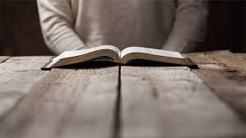
Revisiting our commitment to God. (vs 1-2)
¹ Therefore, since Christ suffered in his body, arm yourselves also with the same attitude, because whoever suffers in the body is done with sin. ² As a result, they do not live the rest of their earthly lives for evil human desires, but rather for the will of God.
It requires a decision
It requires an action
It requires sacrifices

Slide 6
Revisiting our commitment to God. (vs 1-2)
Decision
Action
Sacrifice
because whoever suffers in the body is done with sin
Arm yourself with the same mind:
Since Christ suffered for us in the flesh,

Slide 7
Revisiting our commitment to God. (vs 1-2)
“Whoever has suffered for doing right, and has still gone on obeying God in spite of the suffering it involved, has made a clear break with sin.” (Grudem)
Edmond Hiebert “Depicts the spiritual state of the victorious sufferer. It carries a note of triumph; he has effectively broken with a life dominated by sin. It need not mean that he no longer commits any act of sin, but that his old life, dominated by the power of sin, has been terminated.”
If we have not physically suffered for following Jesus Christ, we can still connect ourselves by faith to Jesus, who has suffered for us in the flesh. “I beg you to remember that there is no getting quit of sin – there is no escaping from its power – except by contact and union with the Lord Jesus Christ.” (Spurgeon)

Slide 8
Revisiting our commitment to God. (vs 1-2)
Peter uses 2-time references to help us:
First, “DO NOT” or no longer (in other versions) should we live in sin, and we should answer every temptation and sinful impulse with the reply, “no longer.”
Second, we should carefully consider how to live the rest of our time. God has appointed us some further days on this earth; when each of us must answer to Him how we live this time.

Slide 9
The Need for Godly Wisdom. (vs 3-6)
3 For you have spent enough time in the past doing what pagans choose to do—living in debauchery, lust, drunkenness, orgies, carousing and detestable idolatry. 4 They are surprised that you do not join them in their reckless, wild living, and they heap abuse on you. 5 But they will have to give account to him who is ready to judge the living and the dead. 6 For this is the reason the gospel was preached even to those who are now dead, so that they might be judged according to human standards in regard to the body, but live according to God in regard to the spirit.

Slide 10
The Need for Godly Wisdom. (vs 3-6)
Honours ‘ME’
Honours God

Slide 11
The Need for Godly Wisdom. (vs 3-6)
For you have spent enough time in the past doing what pagans choose to do—living in debauchery, lust, drunkenness, orgies, carousing and detestable idolatry.
Our Language is different
Our Goals are different
Honours ‘ME’
Honours God

Slide 12
The Need for Godly Wisdom. (vs 3-6)
They are surprised that you do not join them in their reckless, wild living, and they heap abuse on you.
We should expect retaliation…
Expect to define Godliness around us…
Honours ‘ME’
Honours God

Slide 13
The Need for Godly Wisdom. (vs 3-6)
But they will have to give account to him who is ready to judge the living and the dead. 6 For this is the reason the gospel was preached even to those who are now dead, so that they might be judged according to human standards in regard to the body, but live according to God in regard to the spirit.
Trusting God for His justice
Trusting God for His mercy
Honours ‘ME’
Honours God

Slide 14
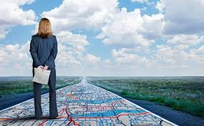
The End in Mind. (vs 7-11)
7 The end of all things is near. Therefore be alert and of sober mind so that you may pray. 8 Above all, love each other deeply, because love covers over a multitude of sins. 9 Offer hospitality to one another without grumbling. 10 Each of you should use whatever gift you have received to serve others, as faithful stewards of God’s grace in its various forms. 11 If anyone speaks, they should do so as one who speaks the very words of God. If anyone serves, they should do so with the strength God provides, so that in all things God may be praised through Jesus Christ. To him be the glory and the power for ever and ever. Amen.

Slide 15
The End in Mind. (vs 7-11)
Jesus said, "My kingdom is not of this world. If it were, my servants would fight to prevent my arrest by the Jewish leaders. But now my kingdom is from another place." John 18:36
We are called to abide in Him and follow.
We are called to obey and surrender.

Slide 16
The End in Mind. (vs 7-11)
The end of all things is near. Therefore be alert and of sober mind so that you may pray.
Prayer
Alert
Watchful
END

Slide 17
The End in Mind. (vs 7-11)
Above all, love each other deeply, because love covers over a multitude of sins.
“Where love abounds in a fellowship of Christians, many small offences, and even some large ones, are readily overlooked and forgotten. But where love is lacking, every word is viewed with suspicion, every action is liable to misunderstanding, and conflicts about – to Satan’s perverse delight.” (Grudem)
Prayer
Alert
Watchful
Love
END

Slide 18
The End in Mind. (vs 7-11)
If anyone speaks, they should do so as one who speaks the very words of God. If anyone serves, they should do so with the strength God provides, so that in all things God may be praised through Jesus Christ.
Prayer
Alert
Watchful
Love
Hospitality
Gifts
END
JESUS

Slide 19
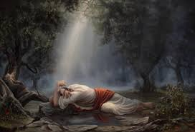
Matthew 26:38-39 (NIV) 38 Then he said to them, “My soul is overwhelmed with sorrow to the point of death. Stay here and keep watch with me.” 39 Going a little farther, he fell with his face to the ground and prayed, “My Father, if it is possible, may this cup be taken from me. Yet not as I will, but as you will.”
His Commitment to God (his Father) was relentless.
His Wisdom was flawless.
His Vision was spot on.

