Slide 1
Sunday Worship Service
6th December 2020

Slide 2
What a Beautiful Name
[Verse]
You were the Word at the beginning
One with God the Lord Most High
Your hidden glory in creation
Now revealed in You our Christ

Slide 3
What a Beautiful Name
[Chorus]
What a beautiful name it is
What a beautiful name it is
The name of Jesus Christ my King

Slide 4
What a Beautiful Name
[Chorus]
What a beautiful name it is
Nothing compares to this
What a beautiful name it is
The name of Jesus

Slide 5
What a Beautiful Name
[Verse]
You didn't want heaven without us
So Jesus, You brought heaven down
My sin was great, Your love was greater
What could separate us now

Slide 6
What a Beautiful Name
[Chorus]
What a wonderful name it is
What a wonderful name it is
The name of Jesus Christ my King

Slide 7
What a Beautiful Name
[Chorus]
What a wonderful name it is
Nothing compares to this
What a wonderful name it is
The name of Jesus

Slide 8
What a Beautiful Name
[Bridge]
Death could not hold You
The veil tore before You
You silenced the boast of sin and grave

Slide 9
What a Beautiful Name
[Bridge]
The heavens are roaring
The praise of Your glory
For You are raised to life again

Slide 10
What a Beautiful Name
[Bridge]
You have no rival
You have no equal
Now and forever, our God reigns

Slide 11
What a Beautiful Name
[Bridge]
Yours is the kingdom
Yours is the glory
Yours is the name above all names

Slide 12
What a Beautiful Name
[Chorus]
What a powerful name it is
What a powerful name it is
The name of Jesus Christ my King

Slide 13
What a Beautiful Name
[Chorus]
What a powerful name it is
Nothing can stand against
What a powerful name it is
The name of Jesus

Slide 14
What a Beautiful Name
[Bridge]
You have no rival
You have no equal
Now and forever, our God reigns

Slide 15
What a Beautiful Name
[Bridge]
Yours is the kingdom
Yours is the glory
Yours is the name above all names

Slide 16
What a Beautiful Name
[Chorus]
What a beautiful name it is
What a beautiful name it is
The name of Jesus Christ my King

Slide 17
What a Beautiful Name
[Chorus]
What a beautiful name it is
Nothing compares to this
What a beautiful name it is
The name of Jesus

Slide 18
What a Beautiful Name
[Chorus]
What a powerful name it is
What a powerful name it is
The name of Jesus Christ my King

Slide 19
What a Beautiful Name
[Chorus]
What a powerful name it is
Nothing can stand against
What a powerful name it is
The name of Jesus

Slide 21
Emmanuel
[Verse]
Holy, Holy, I will bow before
My Lord and King
Hallelujah!
You have come to us
You make all things new

Slide 22
Emmanuel
[Chorus]
Emmanuel, Jesus Christ
You'll never let me go
My shepherd King
You're watching over me
Emmanuel

Slide 23
Emmanuel
[Verse]
So amazing, You have named the stars
Of the deepest night
Still, You love me
You have called my name
I will follow You

Slide 24
Emmanuel
[Chorus]
Emmanuel, Jesus Christ
You'll never let me go
My shepherd King
You're watching over me
Emmanuel

Slide 25
Emmanuel
[Bridge]
Holy, Holy, God Almighty
There is none like You
Holy, Holy, God Almighty
There is none like You

Slide 26
Emmanuel
[Chorus]
Emmanuel, Jesus Christ
You'll never let me go
My shepherd King
You're watching over me
Emmanuel

Slide 28
In Christ Alone
[Verse]
In Christ alone my hope is found
He is my light, my strength, my song
This cornerstone, this solid ground
Firm through the fiercest drought and storm

Slide 29
In Christ Alone
[Verse]
What heights of love, what depths of peace
When fears are stilled, when strivings cease
My comforter, my all in all
Here in the love of Christ I stand

Slide 30
In Christ Alone
[Verse]
In Christ alone who took on flesh
Fullness of God in helpless babe
This gift of love and righteousness
Scorned by the ones He came to save

Slide 31
In Christ Alone
[Verse]
Till on that cross as Jesus died
The wrath of God was satisfied
For every sin on Him was laid
Here in the death of Christ I stand

Slide 32
In Christ Alone
[Verse]
There in the ground His body lay
Light of the world by darkness slain
Then bursting forth in glorious day
Up from the grave He rose again

Slide 33
In Christ Alone
[Verse]
And as He stands in victory
Sin's curse has lost its grip on me
For I am His and He is mine
Bought with the precious blood of Christ

Slide 34
In Christ Alone
[Verse]
No guilt in life, no fear in death
This is the power of Christ in me
From life's first cry to final breath
Jesus commands my destiny

Slide 35
In Christ Alone
[Verse]
No power of hell, no scheme of man
Can ever pluck me from His hand
Till He returns or calls me home
Here in the power of Christ I'll stand

Slide 36
In Christ Alone
[Verse]
In Christ alone my hope is found
He is my light, my strength, my song
This cornerstone, this solid ground
Firm through the fiercest drought and storm

Slide 37
In Christ Alone
[Verse]
What heights of love, what depths of peace
When fears are stilled, when strivings cease
My comforter, my all in all
Here in the love of Christ I stand

Slide 39
Evidence for Christ
Evidence for Christ
John 5:31 – 47
John 5:31-47

Slide 40
Evidence for Christ
³¹ “If I testify about myself, my testimony is not true. ³² There is another who testifies in my favor, and I know that his testimony about me is true. ³³ “You have sent to John and he has testified to the truth. ³⁴ Not that I accept human testimony; but I mention it that you may be saved. ³⁵ John was a lamp that burned and gave light, and you chose for a time to enjoy his light. ³⁶ “I have testimony weightier than that of John. For the works that the Father has given me to finish—the very works that I am doing—testify that the Father has sent me. ³⁷ And the Father who sent me has himself testified concerning me. You have never heard his voice nor seen his form, ³⁸ nor does his word dwell in you, for you do not believe the one he sent. ³⁹ You study the Scriptures diligently because you think that in them you have eternal life. These are the very Scriptures that testify about me, ⁴⁰ yet you refuse to come to me to have life.
John 5:31-47

Slide 41
Evidence for Christ
⁴¹ “I do not accept glory from human beings, ⁴² but I know you. I know that you do not have the love of God in your hearts. ⁴³ I have come in my Father's name, and you do not accept me; but if someone else comes in his own name, you will accept him. ⁴⁴ How can you believe since you accept glory from one another but do not seek the glory that comes from the only God? ⁴⁵ “But do not think I will accuse you before the Father. Your accuser is Moses, on whom your hopes are set. ⁴⁶ If you believed Moses, you would believe me, for he wrote about me. ⁴⁷ But since you do not believe what he wrote, how are you going to believe what I say?” (John 5:31 – 47)
John 5:31-47

Slide 42
Evidence for Christ
BACKDROP
Healing on the Sabbath. Redefining the Sabbath
¹⁷ “My Father is always at his work to this very day, and I too am working.” ¹⁸ For this reason they tried all the more to kill him; not only was he breaking the Sabbath, but he was even calling God his own Father, making himself equal with God. (John 5:17 – 18)
²⁴ “Very truly I tell you, whoever hears my word and believes him who sent me has eternal life and will not be judged but has crossed over from death to life. ²⁵ Very truly I tell you, a time is coming and has now come when the dead will hear the voice of the Son of God and those who hear will live. ²⁶ For as the Father has life in himself, so he has granted the Son also to have life in himself. ²⁷ And he has given him authority to judge because he is the Son of Man. (John 5:24 – 27)
John 5:31-47

Slide 43
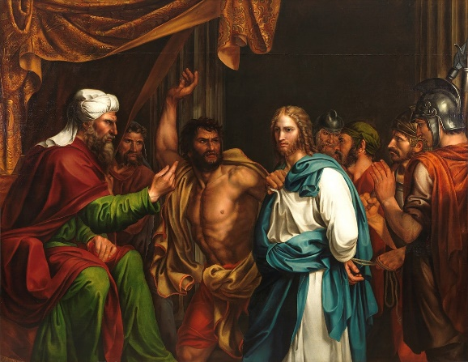
Evidence for Christ
JESUS ON TRIAL
Who does Jesus claim to be?
¹⁸ For this reason they tried all the more to kill him; not only was he breaking the Sabbath, but he was even calling God his own Father, making himself equal with God. (John 5:18)
³¹ “If I testify about myself, my testimony is not true. (John 5:31)
Jesus is not the only one talking about Himself.
John 5:31-47

Slide 44
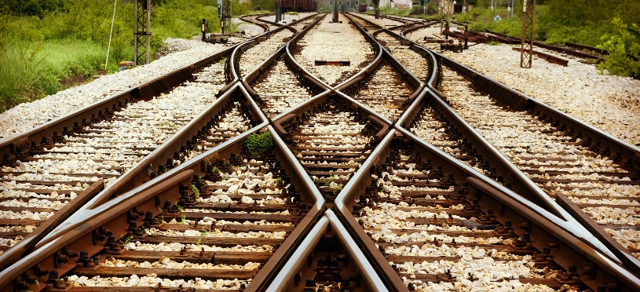
Evidence for Christ
WHAT ARE THE IMPLICATIONS
Is there another way?
Who will decide what is right?
Who can save you?
Who will judge all things?
²⁴ “Therefore everyone who hears these words of mine and puts them into practice is like a wise man who built his house on the rock. (Matthew 7:24)
John 5:31-47

Slide 45
Evidence for Christ
EVIDENCE OF CHRIST
³¹ “If I testify about myself, my testimony is not true. ³² There is another who testifies in my favor, and I know that his testimony about me is true. (John 5:31 – 32)
John
Works
Scripture (Moses)
God the Father
John 5:31-47

Slide 46
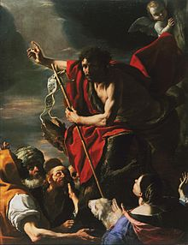
Evidence for Christ
JOHN
³³ “You have sent to John and he has testified to the truth. ³⁴ Not that I accept human testimony; but I mention it that you may be saved. ³⁵ John was a lamp that burned and gave light, and you chose for a time to enjoy his light. (John 5:33 – 35)
John pointed to Jesus.
Jesus mentions this for their sake.
They looked to John while he was there yet they fail to see who John was pointing to. They missed the point.
John 5:31-47

Slide 47
Evidence for Christ
WORK OF JESUS
³⁶ “I have testimony weightier than that of John. For the works that the Father has given me to finish—the very works that I am doing—testify that the Father has sent me. (John 5:36)
Restoration, Healing and Others signs.
The word of Jesus Christ.
⁴⁹ The royal official said, “Sir, come down before my child dies.” ⁵⁰ “Go,” Jesus replied, “your son will live.” (John 4:49 – 50)
⁸ Then Jesus said to him, “Get up! Pick up your mat and walk.” ⁹ At once the man was cured; he picked up his mat and walked. (John 5:8 – 9)
John 5:31-47

Slide 48
Evidence for Christ
GOD THE FATHER
³⁷ And the Father who sent me has himself testified concerning me. (John 5:37)
Jesus and God the Father
¹⁹ Jesus gave them this answer: “Very truly I tell you, the Son can do nothing by himself; he can do only what he sees his Father doing, because whatever the Father does the Son also does. ²⁰ For the Father loves the Son and shows him all he does. Yes, and he will show him even greater works than these, so that you will be amazed. ²¹ For just as the Father raises the dead and gives them life, even so the Son gives life to whom he is pleased to give it. ²² Moreover, the Father judges no one, but has entrusted all judgment to the Son, ²³ that all may honor the Son just as they honor the Father. Whoever does not honor the Son does not honor the Father, who sent him. (John 5:19 – 23)
John 5:31-47

Slide 49
Evidence for Christ
THE SCRIPTURES
³⁹ You study the Scriptures diligently because you think that in them you have eternal life. These are the very Scriptures that testify about me, ⁴⁰ yet you refuse to come to me to have life. (John 5:39 – 40)
⁴⁶ If you believed Moses, you would believe me, for he wrote about me. ⁴⁷ But since you do not believe what he wrote, how are you going to believe what I say?” (John 5:46 – 47)
A pursuit of knowledge for knowledge sake.
It’s not what you know but who you believe. His word matters to us because it is Him we seek.
John 5:31-47

Slide 50
Evidence for Christ
BLINDED BY RELIGION
John 5:37 – 38
You have never heard his voice
nor seen his form,
nor does his word dwell in you,
for you do not believe the one he sent.
The could not see God standing before them.
They could not connect with what God was doing through His Son.
They word of God has not made it’s way into their hearts.
Their form of religion has blinded in such a way that they could not see and know Jesus.
John 5:31-47

Slide 51
Evidence for Christ
WHY DO WE PURSUE GOD?
God I am okay and I have everything under control.
Please STAY OUT.
God I am in a mess I need you.
Please COME IN.
John 5:31-47

Slide 52
Evidence for Christ
THE TESTIMONY AND GLORY OF PEOPLE
⁴³ I have come in my Father's name, and you do not accept me; but if someone else comes in his own name, you will accept him. ⁴⁴ How can you believe since you accept glory from one another but do not seek the glory that comes from the only God? (John 5:43 – 44)
Preoccupied with worldly endorsements and praises.
Jesus did not come for such praises and endorsements.
²³ Now while he was in Jerusalem at the Passover Festival, many people saw the signs he was performing and believed in his name. ²⁴ But Jesus would not entrust himself to them, for he knew all people. ²⁵ He did not need any testimony about mankind, for he knew what was in each person. (John 2:23 – 25)
John 5:31-47

Slide 53
Evidence for Christ
WHO IS THE JUDGE AND WHO IS ON THE STAND
³⁹ You study the Scriptures diligently because you think that in them you have eternal life. These are the very Scriptures that testify about me, ⁴⁰ yet you refuse to come to me to have life. ⁴¹ “I do not accept glory from human beings, ⁴² but I know you. I know that you do not have the love of God in your hearts. ⁴³ I have come in my Father's name, and you do not accept me; but if someone else comes in his own name, you will accept him. ⁴⁴ How can you believe since you accept glory from one another but do not seek the glory that comes from the only God? ⁴⁵ “But do not think I will accuse you before the Father. Your accuser is Moses, on whom your hopes are set. ⁴⁶ If you believed Moses, you would believe me, for he wrote about me. ⁴⁷ But since you do not believe what he wrote, how are you going to believe what I say?” (John 5:39 – 47)
John 5:31-47

Slide 54
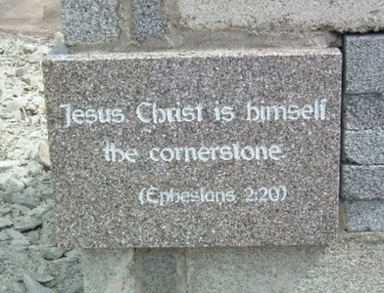
Evidence for Christ
JESUS THE PRECIOUS CORNERSTONE
⁴ As you come to him, the living Stone—rejected by humans but chosen by God and precious to him— ⁵ you also, like living stones, are being built into a spiritual house to be a holy priesthood, offering spiritual sacrifices acceptable to God through Jesus Christ. ⁶ For in Scripture it says: “See, I lay a stone in Zion, a chosen and precious cornerstone, and the one who trusts in him will never be put to shame.”
John 5:31-47

Slide 55
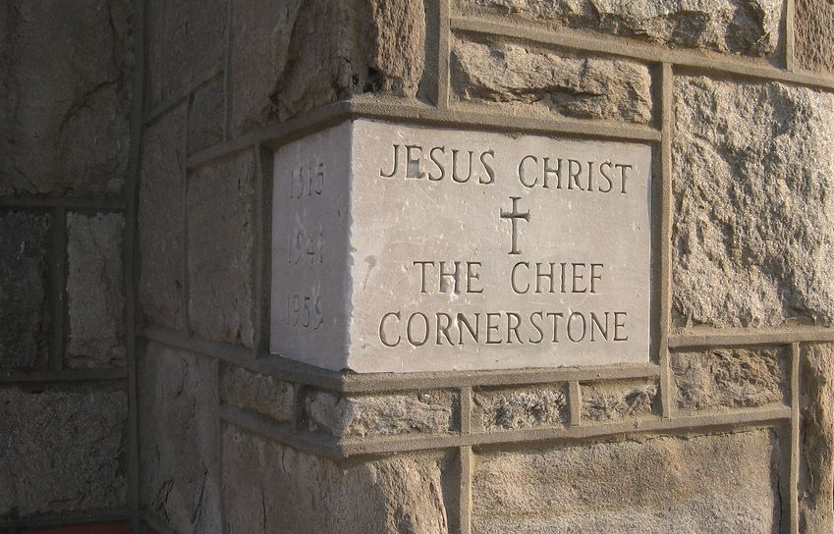
Evidence for Christ
JESUS THE PRECIOUS CORNERSTONE
⁷ Now to you who believe, this stone is precious. But to those who do not believe, “The stone the builders rejected has become the cornerstone,” ⁸ and, “A stone that causes people to stumble and a rock that makes them fall.” (1 Peter 2:4 – 8)
John 5:31-47

Slide 56
Evidence for Christ
CHRIST THE JUDGE
¹⁷ For God did not send his Son into the world to condemn the world, but to save the world through him. ¹⁸ Whoever believes in him is not condemned, but whoever does not believe stands condemned already because they have not believed in the name of God's one and only Son. ¹⁹ This is the verdict: Light has come into the world, but people loved darkness instead of light because their deeds were evil. ²⁰ Everyone who does evil hates the light, and will not come into the light for fear that their deeds will be exposed. ²¹ But whoever lives by the truth comes into the light, so that it may be seen plainly that what they have done has been done in the sight of God. (John 3:17 – 21)
John 5:31-47

Slide 57
Evidence for Christ
WHO IS JESUS CHRIST?
I am trying here to prevent anyone saying the really foolish thing that people often say about Him: I’m ready to accept Jesus as a great moral teacher, but I don’t accept his claim to be God. That is the one thing we must not say. A man who was merely a man and said the sort of things Jesus said would not be a great moral teacher. He would either be a lunatic — on the level with the man who says he is a poached egg — or else he would be the Devil of Hell. You must make your choice. Either this man was, and is, the Son of God, or else a madman or something worse. You can shut him up for a fool, you can spit at him and kill him as a demon or you can fall at his feet and call him Lord and God, but let us not come with any patronizing nonsense about his being a great human teacher. He has not left that open to us. He did not intend to.” ~ C.S Lewis ~
John 5:31-47

Slide 58
Evidence for Christ
WHY JESUS?
Sin: Only Jesus can remove our sin.
Repentance: He invites us to look to Him. We are safe in His hands.
Need for a Saviour and a King: Only He can deliver us and lead us.
Worshiping the Lord: We are made to worship Him.
John 5:31-47

