Slide 1
Sunday Worship Service
14th March 2021

Slide 2
Cornerstone
[Verse]
My hope is built on nothing less
Than Jesus’ blood and righteousness
I dare not trust the sweetest frame
But wholly trust in Jesus’ name

Slide 3
Cornerstone
[Chorus]
Christ alone
Cornerstone
Weak made strong
In the Saviour's love

Slide 4
Cornerstone
[Chorus]
Through the storm
He is Lord
Lord of all

Slide 5
Cornerstone
[Verse]
When darkness seems to hide His face
I rest on His unchanging grace
In every high and stormy gale
My anchor holds within the veil
My anchor holds within the veil

Slide 6
Cornerstone
[Chorus]
Christ alone
Cornerstone
Weak made strong
In the Saviour's love

Slide 7
Cornerstone
[Chorus]
Through the storm
He is Lord
Lord of all

Slide 8
Cornerstone
[Verse]
When He shall come with trumpet sound
Oh, may I then in Him be found
Dressed in His righteousness alone
Faultless stand before the throne

Slide 9
Cornerstone
[Chorus]
Christ alone
Cornerstone
Weak made strong
In the Saviour's love

Slide 10
Cornerstone
[Chorus]
Through the storm
He is Lord
Lord of all

Slide 11
Cornerstone
[Bride]
He is Lord
He is Lord
He is Lord
Lord of all

Slide 13
Once Again
[Verse]
Jesus Christ
I think upon your sacrifice
You became nothing
Poured out to death

Slide 14
Once Again
[Verse]
Many times I've wondered at Your gift of life
I'm in that place once again
I'm in that place once again

Slide 15
Once Again
[Chorus]
Once again I look upon the cross where You died
I'm humbled by Your mercy and I'm broken inside

Slide 16
Once Again
[Chorus]
Once again I thank You
Once again I pour out my life

Slide 17
Once Again
[Verse]
Now You are
Exalted to the highest place
King of the heavens
Where one day I'll bow

Slide 18
Once Again
[Verse]
But for now
I marvel at Your saving grace
I'm full of praise once again
I'm full of praise once again

Slide 19
Once Again
[Chorus]
Once again I look upon the cross where You died
I'm humbled by Your mercy and I'm broken inside

Slide 20
Once Again
[Chorus]
Once again I thank You
Once again I pour out my life

Slide 21
Once Again
[Verse]
Thank you for the cross
Thank you for the cross
Thank you for the cross, my friend

Slide 22
Once Again
[Chorus]
Once again I look upon the cross where You died
I'm humbled by Your mercy and I'm broken inside

Slide 23
Once Again
[Chorus]
Once again I thank You
Once again I pour out my life

Slide 24
Once Again
[Verse]
Thank you for the cross
Thank you for the cross
Thank you for the cross, my friend

Slide 26
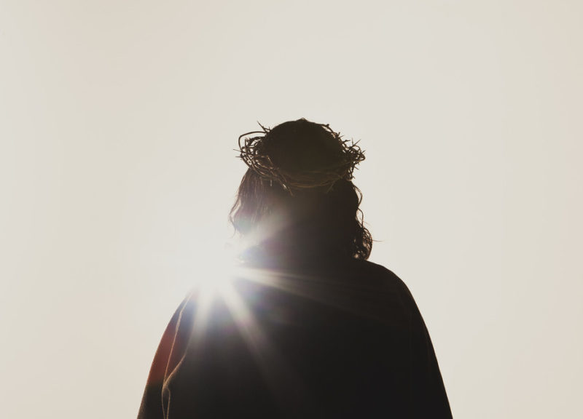
Jesus Christ: The Revelation of God
John 13:31-14:14

Slide 27
John 13:31-14:14
³¹ When he [Judas] was gone, Jesus said, “Now the Son of Man is glorified and God is glorified in him. ³² If God is glorified in him, God will glorify the Son in himself, and will glorify him at once.
³³ “My children, I will be with you only a little longer. You will look for me, and just as I told the Jews, so I tell you now: Where I am going, you cannot come.
³⁴ “A new command I give you: Love one another. As I have loved you, so you must love one another. ³⁵ By this everyone will know that you are my disciples, if you love one another.”
³⁶ Simon Peter asked him, “Lord, where are you going?”
Jesus replied, “Where I am going, you cannot follow now, but you will follow later.”
³⁷ Peter asked, “Lord, why can’t I follow you now? I will lay down my life for you.”
³⁸ Then Jesus answered, “Will you really lay down your life for me? Very truly I tell you, before the rooster crows, you will disown me three times!

Slide 28
John 13:31-14:14
¹ “Do not let your hearts be troubled. You believe in God; believe also in me. ² My Father’s house has many rooms; if that were not so, would I have told you that I am going there to prepare a place for you? ³ And if I go and prepare a place for you, I will come back and take you to be with me that you also may be where I am. ⁴ You know the way to the place where I am going.”
⁵ Thomas said to him, “Lord, we don’t know where you are going, so how can we know the way?”
⁶ Jesus answered, “I am the way and the truth and the life. No one comes to the Father except through me. ⁷ If you really know me, you will know my Father as well. From now on, you do know him and have seen him.”

Slide 29
John 13:31-14:14
⁸ Philip said, “Lord, show us the Father and that will be enough for us.”
⁹ Jesus answered: “Don’t you know me, Philip, even after I have been among you such a long time? Anyone who has seen me has seen the Father. How can you say, ‘Show us the Father’? ¹⁰ Don’t you believe that I am in the Father, and that the Father is in me? The words I say to you I do not speak on my own authority. Rather, it is the Father, living in me, who is doing his work. ¹¹ Believe me when I say that I am in the Father and the Father is in me; or at least believe on the evidence of the works themselves. ¹² Very truly I tell you, whoever believes in me will do the works I have been doing, and they will do even greater things than these, because I am going to the Father. ¹³ And I will do whatever you ask in my name, so that the Father may be glorified in the Son. ¹⁴ You may ask me for anything in my name, and I will do it.

Slide 30
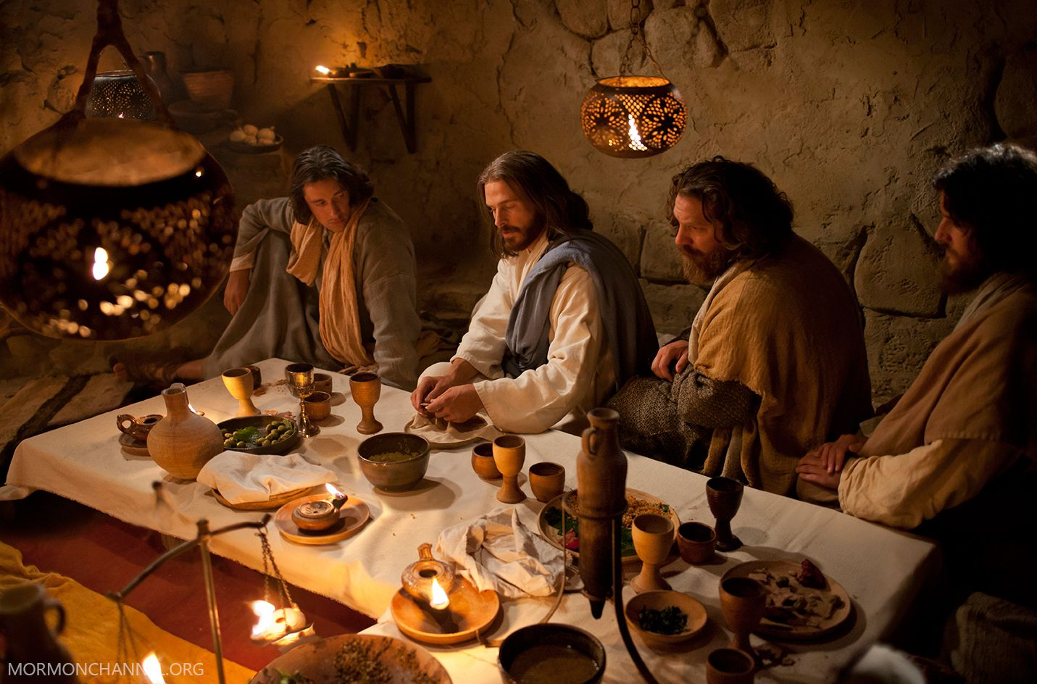
John 13:1
“It was just before the Passover Festival. Jesus knew that the hour had come for him to leave this world and go to the Father. Having loved his own who were in the world, he loved them to the end.”

Slide 31
“Do not let your hearts be troubled” (v. 1)
Jesus was going away
Judas’ betrayal
Peter’s denial
“You believe in God; believe also in me.”

Slide 32
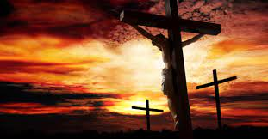
“I am going to prepare a place for you” (vv. 2-4)
² My Father’s house has many rooms; if that were not so, would I have told you that I am going there to prepare a place for you? ³ And if I go and prepare a place for you, I will come back and take you to be with me that you also may be where I am. ⁴ You know the way to the place where I am going.”
John 13:36
“Where I am going, you cannot follow now, but you will follow later.”

Slide 33
Birth of Jesus
The 2nd Coming of Christ
The Cross
Creation
The Age of the Church
& the Holy Spirit

Slide 34
“I am going to prepare a place for you” (vv. 2-4)
John 13:33 “My children, I will be with you only a little longer. You will look for me, and just as I told the Jews, so I tell you now: Where I am going, you cannot come.”
John 8:21, 23-24 ²¹ Once more Jesus said to them, “I am going away, and you will look for me, and you will die in your sin. Where I go, you cannot come.” ²³ But he continued, “You are from below; I am from above. You are of this world; I am not of this world. ²⁴ I told you that you would die in your sins; if you do not believe that I am he, you will indeed die in your sins.”
John 14:4 ⁴ You know the way to the place where I am going.”

Slide 35
“I am the way and the truth and the life” (vv. 5-8)
⁵ Thomas said to him, “Lord, we don’t know where you are going, so how can we know the way?”
⁶ Jesus answered, “I am the way and the truth and the life. No one comes to the Father except through me. ⁷ If you really know me, you will know my Father as well. From now on, you do know him and have seen him.”

Slide 36
“I am the way and the truth and the life” (vv. 5-8)
The Truth | The Life
John 1:14 ¹⁴ The Word became flesh and made his dwelling among us. We have seen his glory, the glory of the one and only Son, who came from the Father, full of grace and truth. | John 1:3-4 ³ Through him all things were made; without him nothing was made that has been made. ⁴ In him was life, and that life was the light of all mankind.
John 1:18 ¹⁸ No one has ever seen God, but the one and only Son, who is himself God and is in closest relationship with the Father, has made him known. | John 6:35 ³⁵ Then Jesus declared, “I am the bread of life. Whoever comes to me will never go hungry, and whoever believes in me will never be thirsty.
John 5:19 ¹⁹ Jesus gave them this answer: “Very truly I tell you, the Son can do nothing by himself; he can do only what he sees his Father doing, because whatever the Father does the Son also does. | John 11:25-26 ²⁵ Jesus said to her, “I am the resurrection and the life. The one who believes in me will live, even though they die; ²⁶ and whoever lives by believing in me will never die.
John 1:1 ¹ In the beginning was the Word, and the Word was with God, and the Word was God. | 1 John 5:20 ²⁰ We know also that the Son of God has come and has given us understanding, so that we may know him who is true. And we are in him who is true by being in his Son Jesus Christ. He is the true God and eternal life.

Slide 37
WHAT IS YOUR PICTURE OF HEAVEN?
?

Slide 38
“Believe that I am in the Father and the Father is in me” (vv. 8-11)
⁸ Philip said, “Lord, show us the Father and that will be enough for us.”
⁹ Jesus answered: “Don’t you know me, Philip, even after I have been among you such a long time? Anyone who has seen me has seen the Father. How can you say, ‘Show us the Father’? ¹⁰ Don’t you believe that I am in the Father, and that the Father is in me? The words I say to you I do not speak on my own authority. Rather, it is the Father, living in me, who is doing his work. ¹¹ Believe me when I say that I am in the Father and the Father is in me; or at least believe on the evidence of the works themselves.

Slide 39
“Believe that I am in the Father and the Father is in me” (vv. 8-11)
God choose to reveal himself through the form of a human being
God made man in his image
Jesus bore the image of the Father, showing us the Father
Jesus showed us how to bear the image of his Father perfectly
Through the cross, we are one with Jesus and one with the Father
The victory of Jesus in his death and resurrection made a way for us to live the way mankind were made for, to be God’s perfect image bearer.

Slide 40
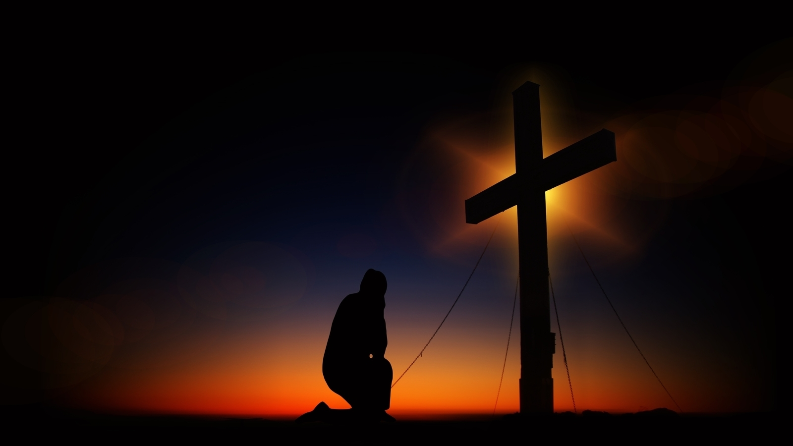
“Whoever believes in me will do my works” (vv. 12-14)
¹² Very truly I tell you, whoever believes in me will do the works I have been doing, and they will do even greater things than these, because I am going to the Father.
John 12:32
“³² And I, when I am lifted up from the earth, will draw all people to myself.”

Slide 41
“Whoever believes in me will do my works” (vv. 12-14)
¹³ And I will do whatever you ask in my name, so that the Father may be glorified in the Son. ¹⁴ You may ask me for anything in my name, and I will do it.
1 John 5:14
¹⁴ This is the confidence we have in approaching God: that if we ask anything according to his will, he hears us.

