Slide 1
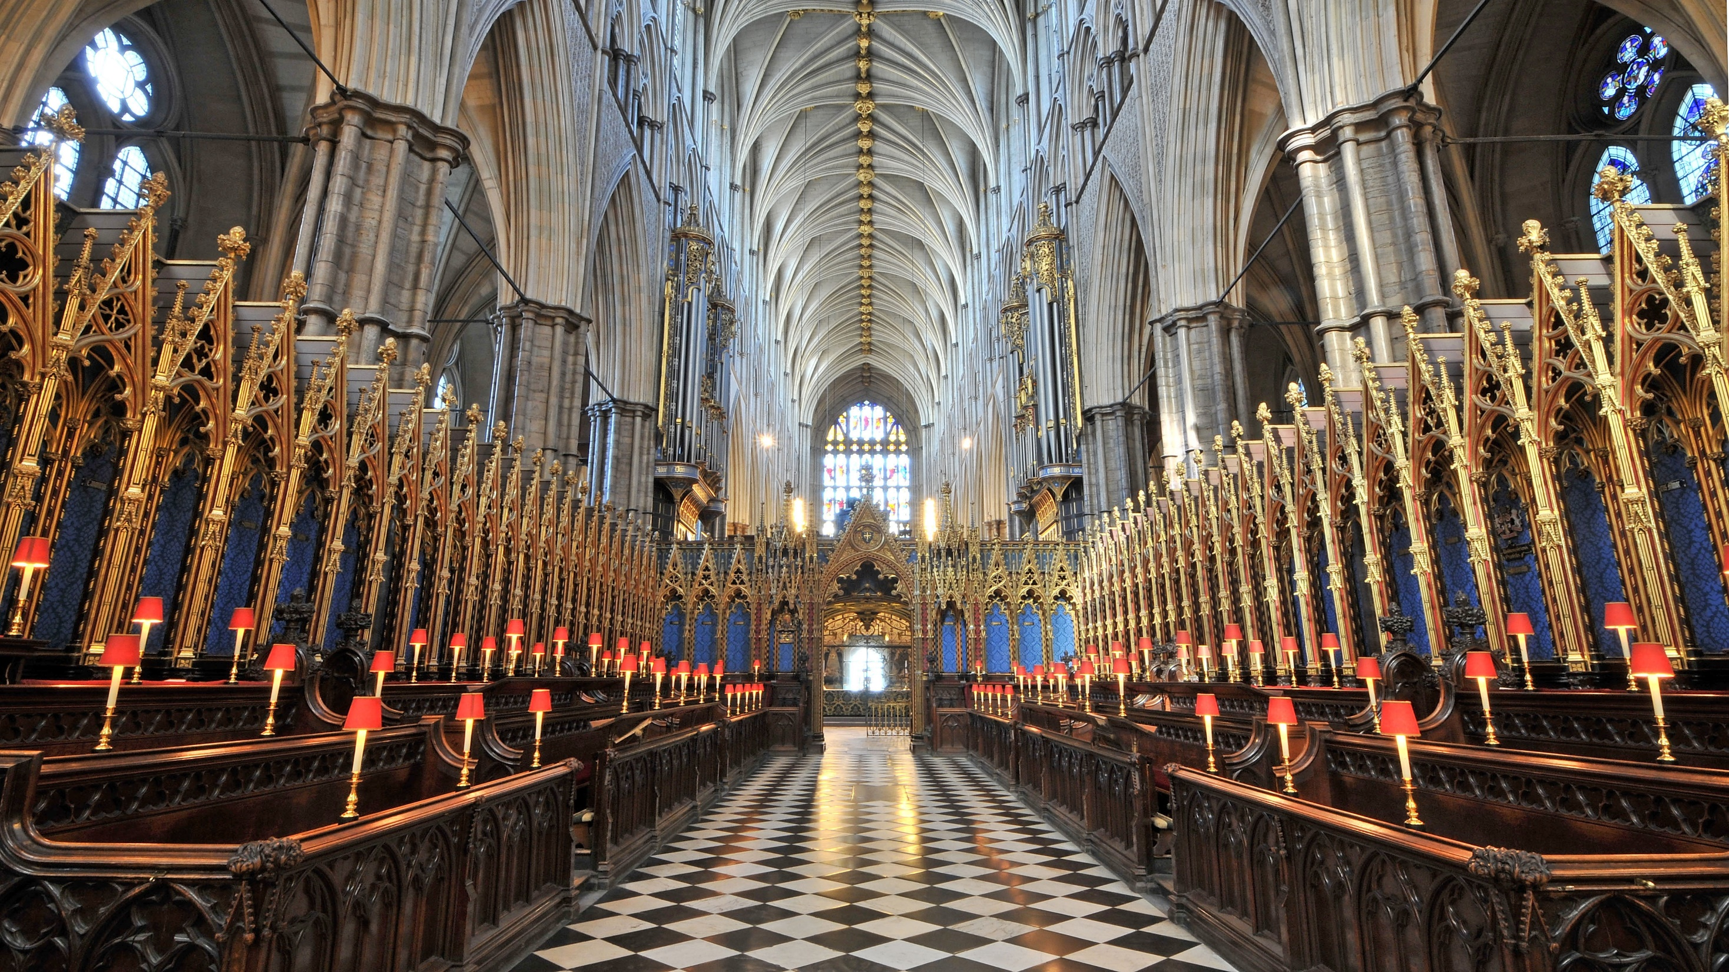
True Religion
Worship, Faith & Devotion to God
Zechariah 7:1 – 14

Slide 2
​¹ In the fourth year of King Darius, the word of the Lord came to Zechariah on the fourth day of the ninth month, the month of Kislev. ² The people of Bethel had sent Sharezer and Regem-Melek, together with their men, to entreat the Lord ³ by asking the priests of the house of the Lord Almighty and the prophets, “Should I mourn and fast in the fifth month, as I have done for so many years?” ⁴ Then the word of the Lord Almighty came to me: ⁵ “Ask all the people of the land and the priests, ‘When you fasted and mourned in the fifth and seventh months for the past seventy years, was it really for me that you fasted? ⁶ And when you were eating and drinking, were you not just feasting for yourselves? ⁷ Are these not the words the Lord proclaimed through the earlier prophets when Jerusalem and its surrounding towns were at rest and prosperous, and the Negev and the western foothills were settled?’” (Zechariah 7:1 – 7)

Slide 3
⁸ And the word of the Lord came again to Zechariah: ⁹ “This is what the Lord Almighty said: ‘Administer true justice; show mercy and compassion to one another. ¹⁰ Do not oppress the widow or the fatherless, the foreigner or the poor. Do not plot evil against each other.’ ¹¹ “But they refused to pay attention; stubbornly they turned their backs and covered their ears. ¹² They made their hearts as hard as flint and would not listen to the law or to the words that the Lord Almighty had sent by his Spirit through the earlier prophets. So the Lord Almighty was very angry. ¹³ “‘When I called, they did not listen; so when they called, I would not listen,’ says the Lord Almighty. ¹⁴ ‘I scattered them with a whirlwind among all the nations, where they were strangers. The land they left behind them was so desolate that no one traveled through it. This is how they made the pleasant land desolate.’” (Zechariah 7:8 – 14)

Slide 4
True Religion
Sermon Series
True Religion
A Godly vision for the future
The Power of God

Slide 5
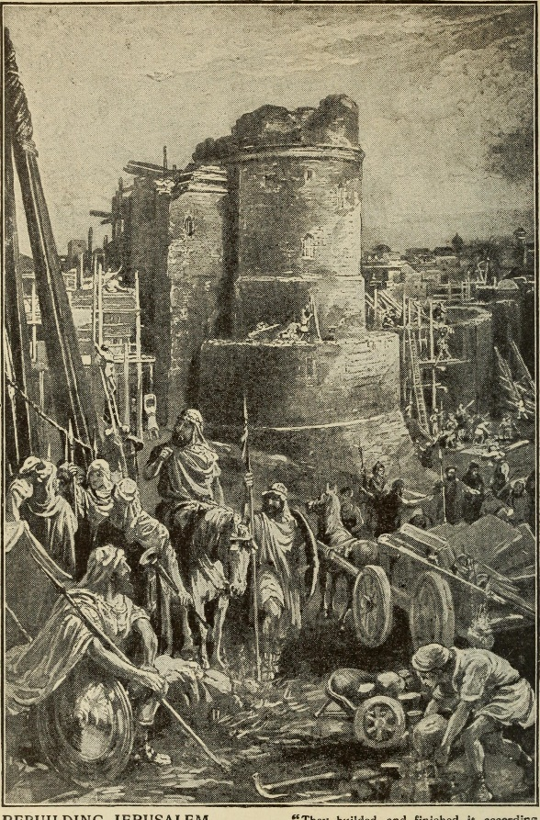
Destruction, Exile and Return
Destruction of Jerusalem by Nebuchadnezzar in 586/587 B.C
Daniel, Esther, Ezra and Nehemiah.
Haggai, Zechariah and Malachi.
539 B.C. Babylon fell to the Persians,
538 B.C. Cyrus issued a decree permitting the exiled Jews to return to Judah and rebuild the temple.
Rebuilding the temple. Life after exile and during the 2nd temple.

Slide 6
¹⁰ This is what the Lord says: “When seventy years are completed for Babylon, I will come to you and fulfill my good promise to bring you back to this place. ¹¹ For I know the plans I have for you,” declares the Lord, “plans to prosper you and not to harm you, plans to give you hope and a future. ¹² Then you will call on me and come and pray to me, and I will listen to you. ¹³ You will seek me and find me when you seek me with all your heart. ¹⁴ I will be found by you,” declares the Lord, “and will bring you back from captivity. I will gather you from all the nations and places where I have banished you,” declares the Lord, “and will bring you back to the place from which I carried you into exile.” (Jeremiah 29:10 – 14)

Slide 7
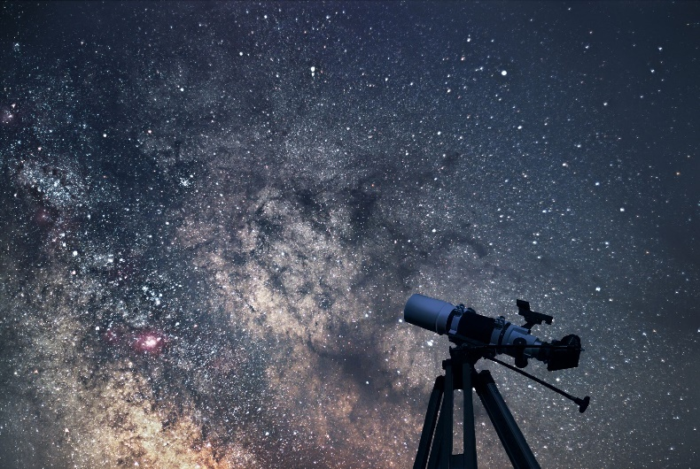
The Question
The excitement of the return faded as the people faced one challenge after another.
People: Where is God in all of this?
God: I am watching, I am jealous for my people. I will restore.
God: Where am I in all your pursuits?

Slide 8
For Whom? God or Yourself?
⁴ Then the word of the Lord Almighty came to me: ⁵ “Ask all the people of the land and the priests, ‘When you fasted and mourned in the fifth and seventh months for the past seventy years, was it really for me that you fasted? ⁶ And when you were eating and drinking, were you not just feasting for yourselves? ⁷ Are these not the words the Lord proclaimed through the earlier prophets when Jerusalem and its surrounding towns were at rest and prosperous, and the Negev and the western foothills were settled?’” (Zechariah 7:4 – 7)

Slide 9
My Word or Your Own Agenda?
¹¹ “But they refused to pay attention; stubbornly they turned their backs and covered their ears. ¹² They made their hearts as hard as flint and would not listen to the law or to the words that the Lord Almighty had sent by his Spirit through the earlier prophets. So the Lord Almighty was very angry. ¹³ “‘When I called, they did not listen; so when they called, I would not listen,’ says the Lord Almighty. ¹⁴ ‘I scattered them with a whirlwind among all the nations, where they were strangers. The land they left behind them was so desolate that no one traveled through it. This is how they made the pleasant land desolate.’” (Zechariah 7:11 – 14)

Slide 10
True Religion
My Spiritual Journey:
A = B
A defines B
B intrudes into A to change everything (Transformation, Sanctification, Renewal).
From knowing God to Life with God ( Vine and Branches).
A | B
Race and Nationalism Success Self Righteousness Acquisition of Power and Wealth Prideful and Selfish Pursuits Power : Transactional/ Control | God Jesus The Cross Loving God and Others

Slide 11
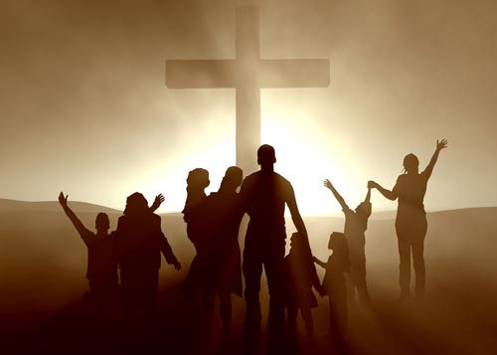
His People
What does it mean to us to have a relationship with God ?
Loved and Accepted
Covenant People
Worship and Devotion.

Slide 12
God is Good
⁹ “This is what the Lord Almighty said: ‘Administer true justice; show mercy and compassion to one another. ¹⁰ Do not oppress the widow or the fatherless, the foreigner or the poor. Do not plot evil against each other.’ ¹¹ “But they refused to pay attention; stubbornly they turned their backs and covered their ears. (Zechariah 7:9 – 11)

Slide 13
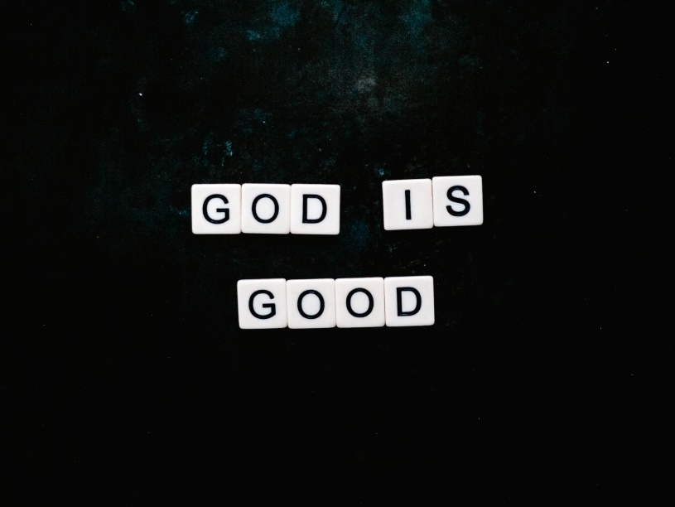
God is Good
⁶ With what shall I come before the Lord and bow down before the exalted God? Shall I come before him with burnt offerings, with calves a year old? ⁷ Will the Lord be pleased with thousands of rams, with ten thousand rivers of olive oil? Shall I offer my firstborn for my transgression, the fruit of my body for the sin of my soul? ⁸ He has shown you, O mortal, what is good. And what does the Lord require of you? To act justly and to love mercy and to walk humbly with your God. (Micah 6:6 – 8)
True religion is not exacting.

Slide 14
True Fasting (Isaiah 58:2 – 11)
² For day after day they seek me out; they seem eager to know my ways, as if they were a nation that does what is right and has not forsaken the commands of its God. They ask me for just decisions and seem eager for God to come near them. ³ ‘Why have we fasted,’ they say, ‘and you have not seen it? Why have we humbled ourselves, and you have not noticed?’

Slide 15
True Fasting (Isaiah 58:2 – 11)
“Yet on the day of your fasting, you do as you please and exploit all your workers. ⁴ Your fasting ends in quarrelling and strife, and in striking each other with wicked fists. You cannot fast as you do today and expect your voice to be heard on high. ⁵ Is this the kind of fast I have chosen, only a day for people to humble themselves? Is it only for bowing one's head like a reed and for lying in sackcloth and ashes? Is that what you call a fast, a day acceptable to the Lord?
“Is this the kind of fast I have chosen, only a day for people to humble themselves?”

Slide 16
True Fasting (Isaiah 58:2 – 11)
⁶ “Is not this the kind of fasting I have chosen: to loose the chains of injustice and untie the cords of the yoke, to set the oppressed free and break every yoke? ⁷ Is it not to share your food with the hungry and to provide the poor wanderer with shelter— when you see the naked, to clothe them, and not to turn away from your own flesh and blood?
True Humility is found in love.
¹⁶ For God so loved the world that he gave his one and only Son, that whoever believes in him shall not perish but have eternal life. ¹⁷ For God did not send his Son into the world
to condemn the world, but to save the world through him. (John 3:16 – 17)
²⁸ just as the Son of Man did not come to be served, but to serve, and to give his life as a ransom for many. (Matthew 20:28)

Slide 17
True Fasting (Isaiah 58:2 – 11)
⁸ Then your light will break forth like the dawn, and your healing will quickly appear; then your righteousness will go before you, and the glory of the Lord will be your rear guard. ⁹ Then you will call, and the Lord will answer; you will cry for help, and he will say: Here am I. “If you do away with the yoke of oppression, with the pointing finger and malicious talk,

Slide 18
True Fasting (Isaiah 58:2 – 11)
¹⁰ and if you spend yourselves in behalf of the hungry and satisfy the needs of the oppressed, then your light will rise in the darkness, and your night will become like the noonday. ¹¹ The Lord will guide you always; he will satisfy your needs in a sun-scorched land and will strengthen your frame.
The favour of God
Light
Healing
Glory of God will be your rear guard.
He will answer you.
The Lord will guide you always.
Satisfy you in a sun scorched land.

Slide 19
What Are We Pursuing?
My Pursuits
My Relationships
My Legacy: Passing the down the faith to my children and others.
My Understanding of the Church (The Body of Christ)
Have I known God’s love in a way that leads me love others?
Me
? ?
? ?
GOD

Slide 20
What Are We Pursuing?
GOD
Love
Mercy
Justice
Holiness
Me

Slide 21
Be Like Minded
​¹ Therefore if you have any encouragement from being united with Christ, if any comfort from his love, if any common sharing in the Spirit, if any tenderness and compassion,
² then make my joy complete by being like-minded, having the same love, being one in spirit and of one mind
³ Do nothing out of selfish ambition or vain conceit. Rather, in humility value others above yourselves, ⁴ not looking to your own interests but each of you to the interests of the others. ⁵ In your relationships with one another, have the same mindset as Christ Jesus: Philippians 2:5
⁶ Who, being in very nature God, did not consider equality with God something to be used to his own advantage; ⁷ rather, he made himself nothing by taking the very nature of a servant, being made in human likeness. ⁸ And being found in appearance as a man, he humbled himself by becoming obedient to death— even death on a cross! (Philippians 2:1 – 8)

Slide 22
True Religion
True religion is not exacting, rather it is about discovering life in Jesus Christ.
True religion is belief that God is good. We worship and celebrate God for who He is.
True Religion allows God to till soil of our hearts with His love.
True religion enables us to move out of secrecy and isolation towards God and each other with love, kindness, grace and truth .
True Religion seeks the will of God and relies on the power of the Holy Spirit.

